Slide 1
VPC

Slide 2
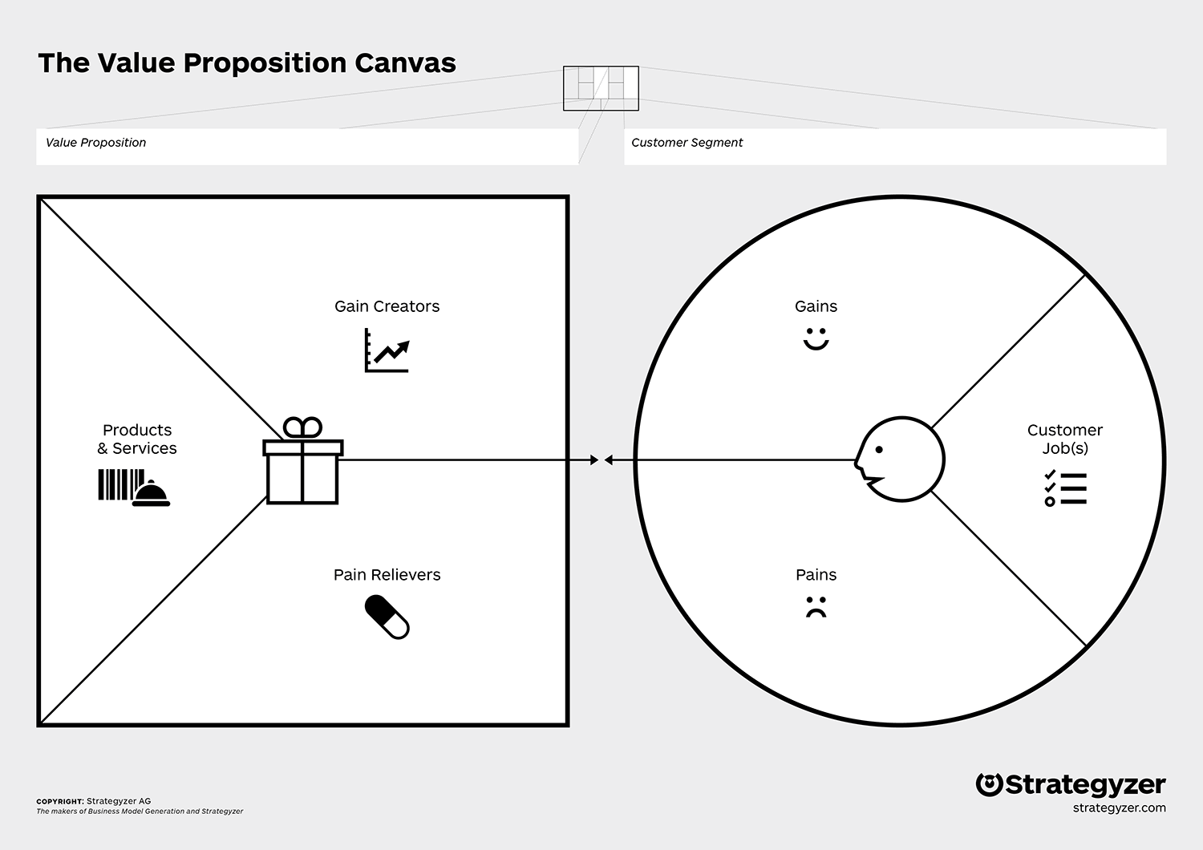
Introduction

Slide 3
Customer Segments

Slide 4
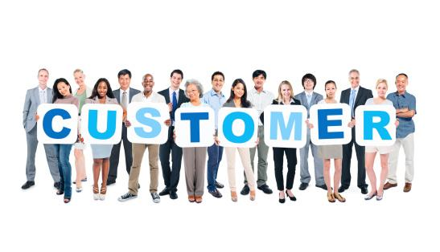
Customer Segments
The Customer Segments Building Block defines
the different groups of people or organizations an
enterprise aims to reach and serve

Slide 5
Customer Segments
Customer groups represent separate segments if:
• Their needs require and justify a distinct offer
• They are reached through different Distribution Channels
• They require different types of relationships
• They have substantially different profitabilities
• They are willing to pay for different aspects of the offer

Slide 6
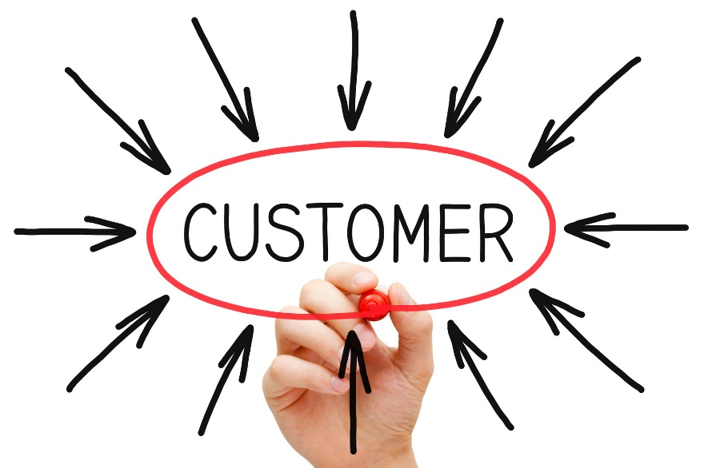
Customer Profiles
The Customer (Segment) Profile describes a specific customer segment in your business model in a more structured and detailed way. It breaks the customer down into its jobs, pains, and gains.

Slide 7
Customer Profiles
Customer Jobs
  what customers are trying to get done in their work and in their lives, as expressed in their own words
Customer Pains
  bad outcomes, risks, and obstacles related to customer jobs
Customer Gains
  the outcomes customers want to achieve or the concrete benefits they are seeking

Slide 8
Customer Jobs
Functional Job
Social Job
Personal / Emotional Job
Supporting Job

Slide 9
Customer Pains
Undesired outcomes, problems, and characteristics
Obstacles
Risks (undesired potential outcomes)

Slide 10
Customer Gains
Required Gains
Expected Gains
Desired Gains
Unexpected Gains

Slide 11
Value Propositions

Slide 12

Value Propositions
The Value Propositions Building Block describes
the bundle of products and services that create
value for a specific Customer Segment

Slide 13
Value Propositions
What value do we deliver to the customer?
Which one of our customer’s problems are we helping to solve?
Which customer needs are we satisfying?
What bundles of products and services are we offering to each Customer Segment?

Slide 14
Value Propositions
Newness
Performance
Customization
“Getting the Job Done”
Design
Brand / Status
Price
Cost Reduction
Risk Reduction
Accessability
Convenience / Usability

Slide 15

Value Map
The Value (Proposition) Map describes the features of a specific value proposition in your business model in a more structured and detailed way. It breaks your value proposition down into products and services, pain relievers, and gain creators

Slide 16
Value Map
Products and Services
  This is a list of all the Products and Service a value proposition is built around
Pain Relievers
  How your products and services alleviate customer pains
Gain Creators
  How your products and services create customer gains

Slide 17
Products and Services
Physical / Tangible
Intangible
Digital
Financial

Slide 18
Pain Relievers
Ask yourself: Could your products and services…
produce savings? In terms of time, money, or efforts.
make your customers feel better? By killing frustrations, annoyances, and other things that give customers a headache.
fix underperforming solutions? By introducing new features, better performance, or enhanced quality.
put an end to difficulties and challenges your customers encounter? By making things easier or eliminating obstacles.
wipe out negative social consequences your customers encounter or fear? In terms of loss of face or lost power, trust, or status.
eliminate risks your customers fear? In terms of financial, social, technical risks, or things that could potentially go wrong.

Slide 19
Pain Relievers
Ask yourself: Could your products and services…
help your customers better sleep at night? By addressing significant issues, diminishing concerns, or eliminating worries.
limit or eradicate common mistakes customers make? By helping them use a solution the right way.
eliminate barriers that are keeping your customer from adopting value propositions? Introducing lower or no upfront investment costs, a flatter learning curve, or eliminating other obstacles preventing adoption.

Slide 20
Gain Creators
Ask yourself: Could your products and services…
create savings that please your customers? In terms of time, money, and effort.
produce outcomes your customers expect or that exceed their expectations? By offering quality levels, more of something, or less of something.
outperform current value propositions and delight your customers? Regarding specific features, performance, or quality.
make your customers’ work or life easier? Via better usability, accessibility, more services, or lower cost of ownership.
create positive social consequences? By making them look good or producing an increase in power or status.

Slide 21
Gain Creators
Ask yourself: Could your products and services…
do something specific that customers are looking for? In terms of good design, guarantees, or specific or more features.
fulfill a desire customers dream about? By helping them achieve their aspirations or getting relief from a hardship?
produce positive outcomes matching your customers’ success and failure criteria? In terms of better performance or lower cost.
help make adoption easier? Through lower cost, fewer investments, lower risk, better quality, improved performance, or better design.

Slide 22
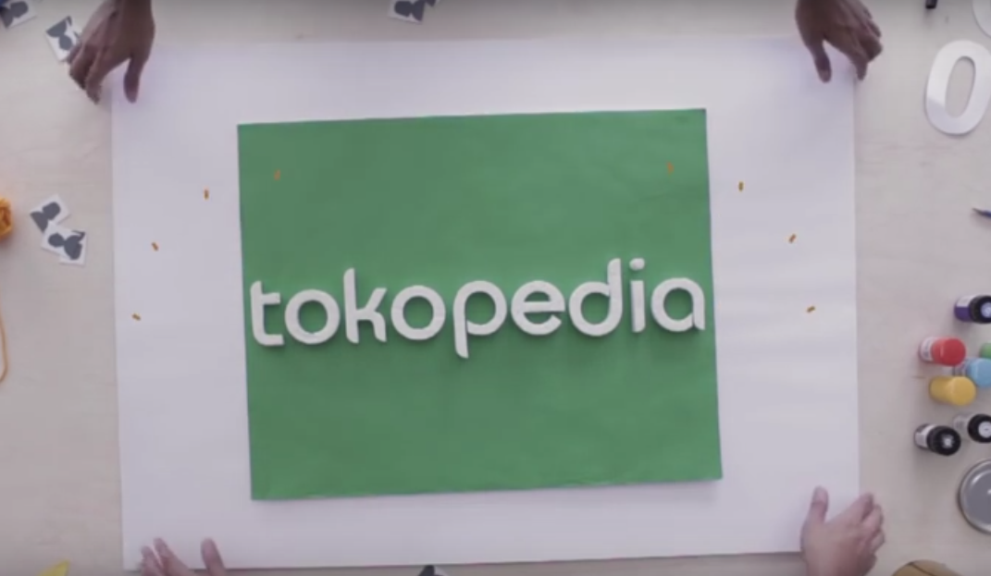
Case
Tokopedia
https://youtu.be/VnkZYzpzRYE
Who are the customer segments of Tokopedia and what are Tokopedia’s value propositions?

